Slide 1
CSE470: Software Engineering
MVC Architecture

Slide 2
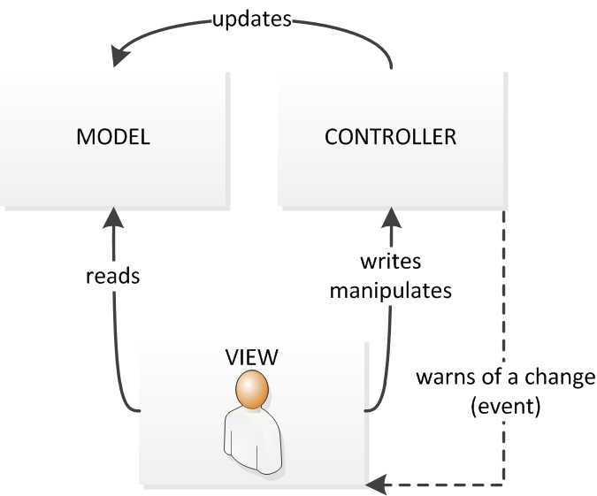
What is MVC Architecture
MVC goes for Model-View-Controller Pattern
Separates presentation and interaction from the data handling logic.
It provides an extensible separation of concern (SOC) from presentation view to data processing logic.

Slide 3
Controller
Handles all the user inputs through url
The interaction to an application starts here by the user interactions – mouse click, key press etc
Process http url requests (GET, POST, PUT, DELETE)
  GET: for getting a data
  POST: for posting / inserting a data
  PUT: for updating a data
  DELETE: for removing a data
Communicates with both Model and View
Contains all server side logic
In the example – ProductController, UserController, AccountController etc.

Slide 4
Model
It refers to the Data Related Logic
Interaction with database (such as SELECT, INSERT, UPDATE, DELETE)
It communicates with the controllers
Can sometimes update or collaborate with the view (Depends on framework)
In the example – Product, User, Transaction, Cart etc are model classes.

Slide 5
View
What the end users see (UI)
Usually Consists of html/css
Communicates with the controller
While coding are passed as dynamic values from the controller
A controller can have multiple associated views.
In the example – product.html, user.html to view a html file

Slide 6

MVC Steps
Model
View
[4] Get Presentation of the product data
[2] Get the product data from DB
[5] Returns the presentation with dynamic rendering
[3] Fetch the data and return to controller
[1] Request: Get a product
Controller
Routes
[6] Returns the response

Slide 7
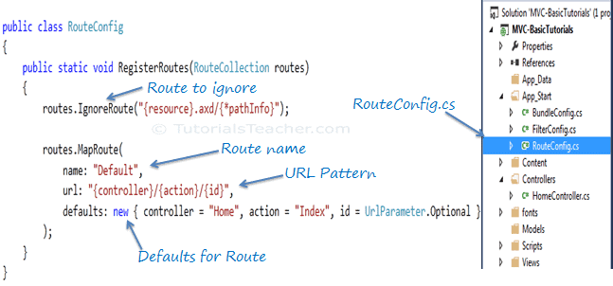
Routes
Are urls to access a resource kept under App_Start folder
General structure - http://domainName/{controller}/{action}/{id}
http://YourApp.com/Users/Profile/25

Slide 8
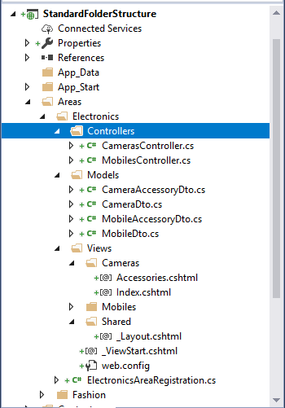
MVC Folder Structure

Slide 9
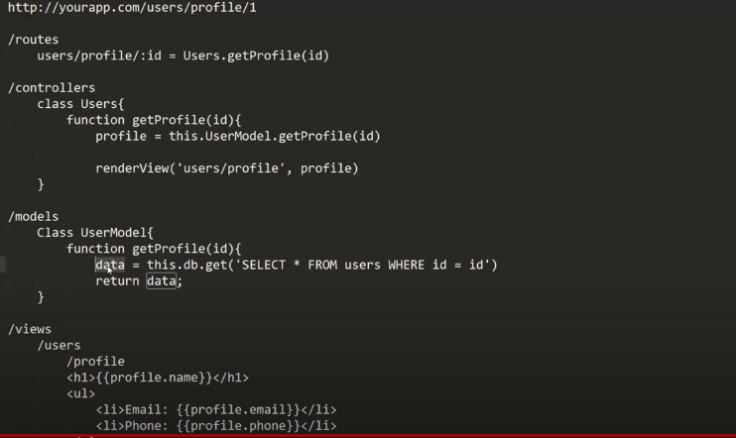
MVC Code Structure

Slide 10
MVC Architecture
Request Flow — Student Record Lookup
Browser → Router → Controller → Model → Database | Database → Model → Controller → View → Browser

Slide 11
Step 1/10
Browser sends GET /students/2021-CSE-047
Request path →
Browser
Student lookup
Router
Controller
2021-CSE-047
Submit
HTTP client
URL → controller
StudentController
User submits → browser fires HTTP GET
View
Database
Model
student_detail.html
MySQL / ORM
StudentModel
← Response path
Network log
→ REQUEST GET /students/2021-CSE-047 — user submits form, browser fires HTTP request

Slide 12
Step 2/10
Router matches URL to Controller
Request path →
✓
Browser
GET /students/2021-CSE-047
Router
Controller
HTTP client
URL → controller
StudentController
GET /students/:id → StudentController@show
View
Database
Model
student_detail.html
MySQL / ORM
StudentModel
← Response path
Network log
→ REQUEST GET /students/2021-CSE-047 received by Router
⟳ ROUTER Pattern match: GET /students/:id → StudentController@show

Slide 13
Step 3/10
Router dispatches request to Controller
Request path →
✓
✓
Browser
Router
dispatch + { id: '2021-CSE-047' }
Controller
HTTP client
URL → controller
StudentController
View
Database
Model
student_detail.html
MySQL / ORM
StudentModel
← Response path
Network log
⟳ ROUTER Route matched — dispatching to StudentController with bound params
⚙ CONTROLLER StudentController.show(id='2021-CSE-047') invoked

Slide 14
Step 4/10
Controller calls Model with bound ID
Request path →
✓
✓
Browser
Router
Controller
HTTP client
URL → controller
StudentController
StudentModel.find('2021-CSE-047')
View
Database
Model
student_detail.html
MySQL / ORM
StudentModel
← Response path
Network log
⚙ CONTROLLER $id = '2021-CSE-047' bound from route param
⚙ CONTROLLER StudentModel.find($id) called — passing bound value to Model

Slide 15
Step 5/10
Model sends SQL query to Database
Request path →
✓
✓
✓
Browser
Router
Controller
HTTP client
URL → controller
StudentController
View
Database
Model
student_detail.html
MySQL / ORM
StudentModel
SELECT * WHERE id='2021-CSE-047'
← Response path
Network log
◈ MODEL ORM builds query: SELECT * FROM students WHERE id = '2021-CSE-047'
⬡ DB SQL query dispatched to database over internal connection

Slide 16
Step 6/10
Database returns result row to Model
Request path →
✓
✓
✓
Browser
Router
Controller
HTTP client
URL → controller
StudentController
✓
View
Database
{ student row }
Model
student_detail.html
MySQL / ORM
StudentModel
← Response path
Network log
Result: 1 row found
⬡ DB Query executed in 4ms — 1 row found (Rafiul Hasan)
name:
Rafiul Hasan
cgpa:
3.72
⬡ DB Raw row { id, name, dept, cgpa, semester, status } returned to Model
dept:
CSE
semester:
8th

Slide 17
Step 7/10
Model returns bound $student object to Controller
Request path →
✓
✓
Browser
Router
Controller
HTTP client
URL → controller
StudentController
$student (hydrated object)
View
✓
✓
Database
Model
student_detail.html
MySQL / ORM
StudentModel
← Response path
Network log
◈ MODEL Row mapped → Student object: { name, dept, cgpa, semester, status }
⚙ CONTROLLER $student hydrated object received back in Controller

Slide 18
Step 8/10
Controller passes $student to View
Request path →
✓
✓
✓
Browser
Router
Controller
HTTP client
URL → controller
StudentController
View
✓
✓
Database
Model
student_detail.html
MySQL / ORM
StudentModel
$student → view
← Response path
Network log
⚙ CONTROLLER $student object ready — calling return view('student_detail', $student)
◻ VIEW View receives $student data — beginning template compilation

Slide 19
Step 9/10
View renders student_detail.html template
Request path →
✓
✓
✓
Browser
Router
Controller
HTTP client
URL → controller
StudentController
View
✓
✓
Database
Model
student_detail.html
MySQL / ORM
StudentModel
← Response path
{{ $student->name }} → Rafiul Hasan
Network log
◻ VIEW Blade/template engine binding {{ $student->name }}, {{ $student->cgpa }}…
◻ VIEW 200 OK response compiled — HTML ready to send back through Router to Browser

Slide 20
Step 10/10
200 OK HTML response delivered to Browser
Request path →
Browser
✓
✓
Router
Controller
HTTP client
URL → controller
StudentController
200 OK HTML response
✓
✓
✓
View
Database
Model
student_detail.html
MySQL / ORM
StudentModel
← Response path
Network log
◻ VIEW View → Router → Browser: 200 OK with compiled student_detail.html
✓ RESPONSE Browser renders page — MVC cycle complete in ~180ms

Slide 21
MVC cycle complete — student page rendered
✓
RH
Controller
Rafiul Hasan
2021-CSE-047 · rendered via student_detail.html
CGPA
SEMESTER
✓
Model
3.72 / 4.00
8th
DEPARTMENT
STATUS
CSE
Active
Network log
✓ RESPONSE 200 OK — MVC cycle complete — student_detail.html rendered in browser
✓ RESPONSE Full path: Browser → Router → Controller → Model → Database → Model → Controller → View → Browser

Slide 22
MVC request lifecycle
1
Browser fires GET /students/2021-CSE-047
6
Database returns raw row to Model
2
Router pattern-matches URL to controller
7
Model returns hydrated $student to Controller
3
Router dispatches + bound { id } to Controller
8
Controller passes $student to View
4
Controller calls Model.find($id)
9
View renders HTML template
5
Model sends SQL query to Database
10
200 OK HTML delivered to Browser
Entire MVC cycle completes in under 200ms

Slide 23
When to use MVC
Large or Complex Applications
Frequent UI or Logic Updates
Note: Your final project MUST follow MVC Architecture

Slide 24
Advantages-Disadvantages
Advantages:
Allows the data to change independently of its representation and vice versa. Supports presentation of the same data in different ways with changes made in one representation shown in all of them. Other advantages are: parallel working, improved testability, code reusability
Disadvantages:
Can involve additional code and code complexity when the data model and interactions are simple.
JavaScript-based MVC Web App: Click here

